Slide 1
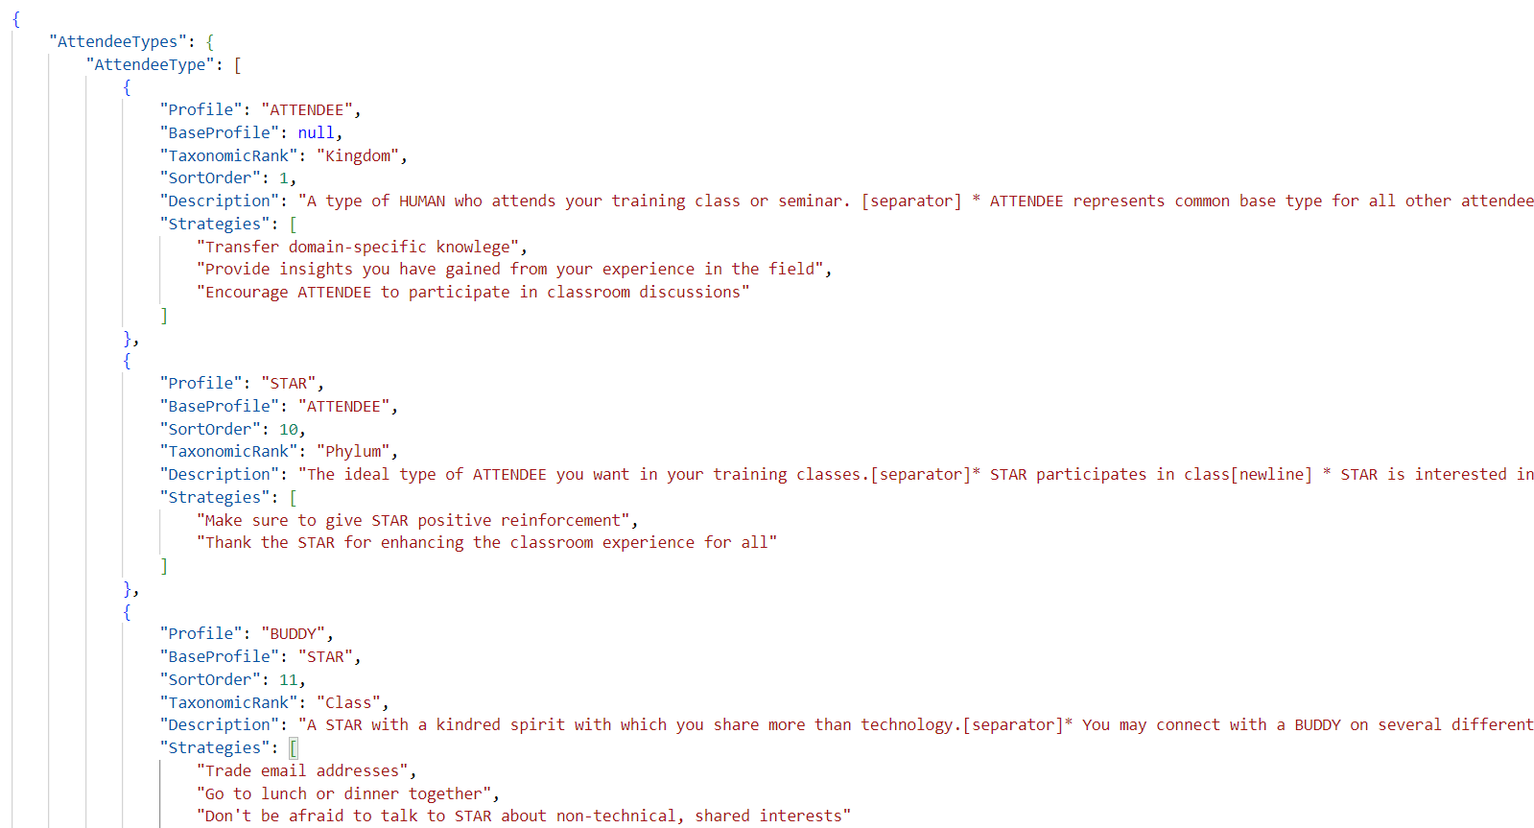
Project data stored in profiles.json
Pointer to base profile
Pointer to base profile

Slide 2
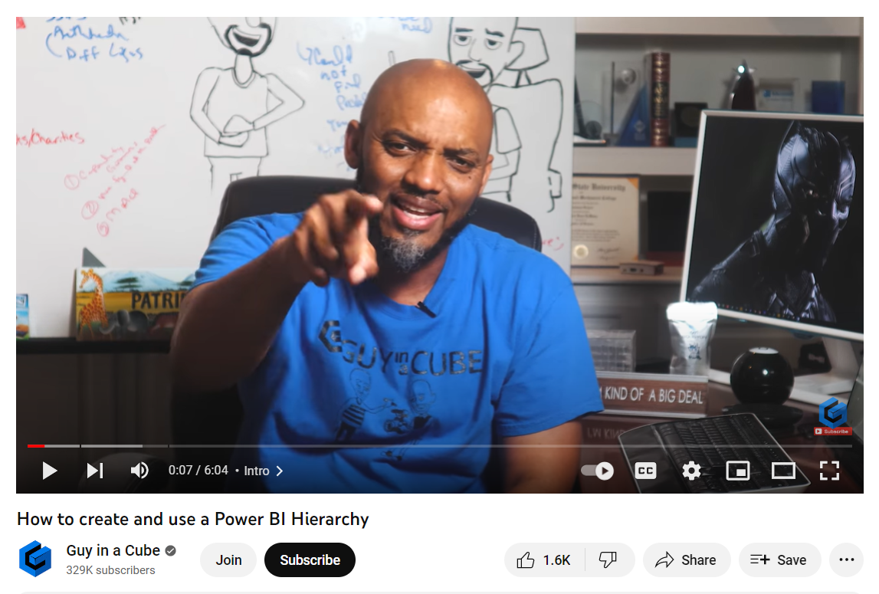
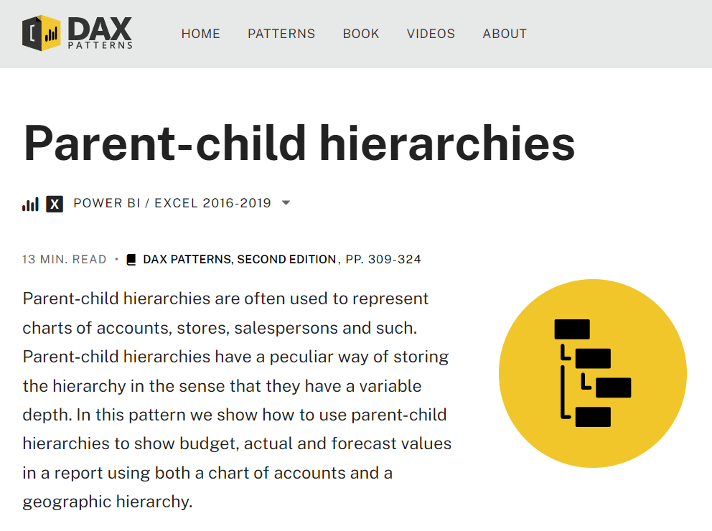
Learning About Hierarchies in Power BI

Slide 3
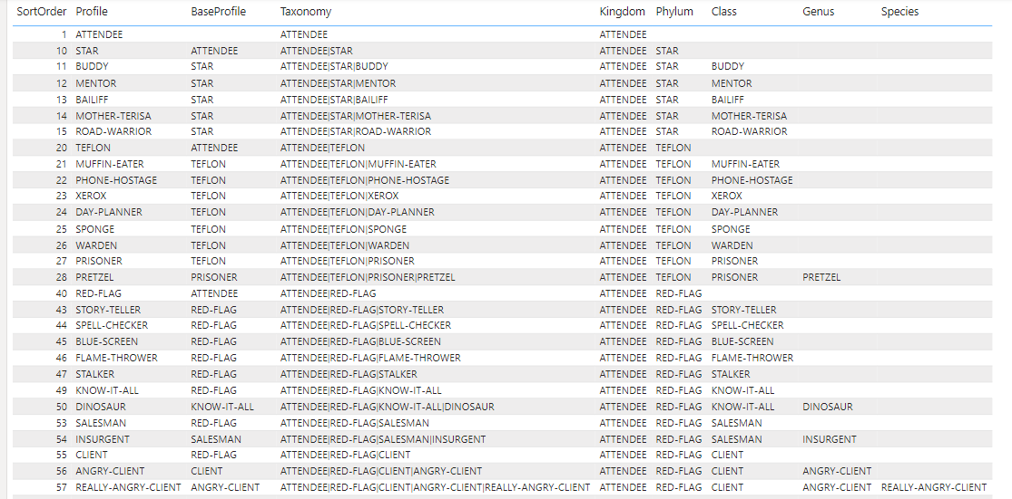

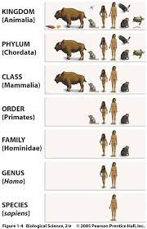
Implementing a Jagged Hierarchy in Power BI Desktop

Slide 4
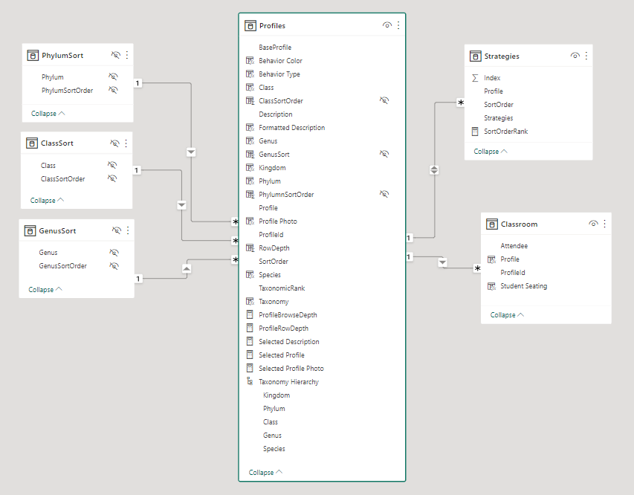
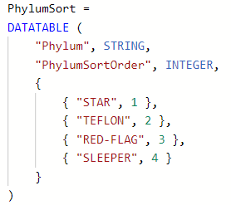
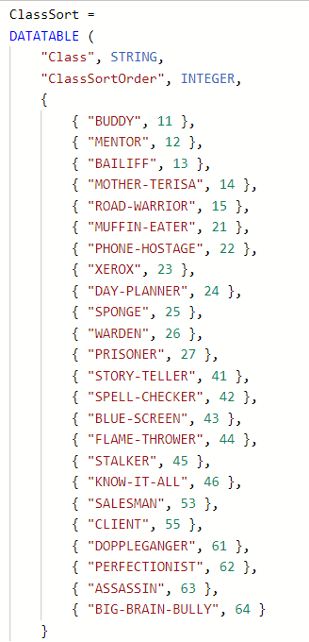
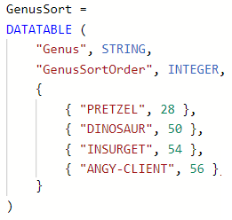
Sorting within Hierarchy Levels
Level 2 Sort
Level 3 Sort
Level 4 Sort

Slide 5
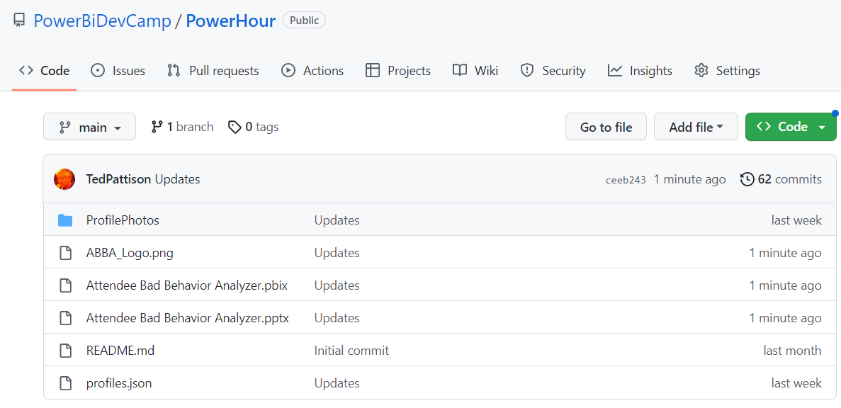
Download the sample code from GitHub
https://github.com/PowerBiDevCamp/PowerHour

